Slide 1
User Interface Tier for Web Applications
Praveen Kumar
Computer Science and Engineering
Ohio State University
Notes:
Welcome to the lecture on user interface tier for web applications. The goal for today is to become familiar with key technologies that are used for developing user interface of a modern web application.

Slide 2
Agenda
Cascading Style Sheet (CSS)
XML & AJAX
Web UI Tier Overview
Single Page Web Application
Summary
Hyper Text Markup Language (HTML)
JavaScript
Notes:
The agenda for today is:
Web User Interface Tier Overview
Hyper Text Markup Language (HTML)
Cascading Style Sheet (CSS)
JavaScript
XML & AJAX
Single Page Web App
Summary

Slide 3
Part 1 of 3 – UI tier Overview & HTML
Notes:
Let’s begin part 1 – UI tier Overview & HTML

Slide 4



Web UI Tier Overview
Web Pages consist of three things:
Content
paragraphs, lists, images, videos, hyperlinks, forms, table, etc.
Presentation
color, font, positioning of content, margins, and other layout details
Behavior
manipulation of page data, error checking, special effects, etc.
Notes:
Web pages consist of essentially three things
(1) Content. This may include paragraphs, lists, images, videos, hyperlinks, forms, table, etc.
(2) Presentation. This includes color, font, positioning of the content, margins, and other layout details
(3) Behavior. This includes manipulation of page data, error checking, special effects such as hover text etc.
The content is created using Hypertext Markup Language or HTML. The presentation is handled using Cascading Stylesheet of CSS, and the dynamic behavior is implemented using JavaScript.
Today, you will learn about all these technologies so that you can construct user interface for a modern web application.

Slide 5
HTML
Hyper Text Markup Language (HTML), is standard language for creating web pages
HTML pages are read & rendered by web browsers (Chrome, IE, Firefox, Safari, etc.)
HTML describes semantic structure
World Wide Web Consortium (W3C) defines the language specification
Current version 5 was released in 2012
Notes:
Let’s begin with HTML.
Hyper Text Markup Language or HTML, is the standard language for creating web pages
HTML pages are read & rendered by web browsers such as Chrome, IE, Firefox, Safari, etc.
HTML describes semantic structure of a web page, i.e. it focuses on the meaning of the encoded information on the web page, rather than its presentation.
World Wide Web Consortium (W3C) defines the language specification, and
The Current version, 5, was released in 2012, and it is widely known as HTML 5.

Slide 6
Example HTML page
An example HTML file (example.html) which the browser can read and render
<!DOCTYPE html>
<html lang="en">
<header>
<meta charset="utf-8">
<title>My First HTML5 Page</title>
<link rel="stylesheet" href="style.css">
</header>
<section>
<p>HTML 5 is fun!</p>
</section>
</html>
Notes:
Here is an example HTML file which the browser can read and render. If you save this text into a file, say example.html, and them open with a browser, you will see a paragraph text displayed that will read: HTML 5 is fun!
As you can see here, there is text inside angle brackets: such as html, header, title, link, section etc. They are called HTML elements. The text outside of HTML elements, such as “HTML 5 is fun!”, is the actual content of the web page which will be displayed by browser. HTML elements mark-up, or encode the page content.
Let’s learn more about HTML elements next.

Slide 7
HTML Elements
Elements consist of a pair of tags with angle brackets. Opening tag can have attributes.
Elements can be nested
HTML elements form the building blocks
<p align=“left”> CSE 5234 – Distributed Enterprise Computing </p>
Paragraph element with alignment attribute
(opening tag)
Textual Content
Closing Tag
Notes:
HTML elements consist of a pair of tags with angle brackets. The opening tag can have attributes.
HTML elements can be nested. Meaning that another element can appear in the content section of an element.
HTML elements form the building blocks of a web page
Here is an example of a paragraph element. The opening tag “p” has an attribute called align. A value of “left” has been assigned to the attribute which means that the paragraph will be aligned to the left of the page.
Between the opening and closing tags, is the actual text, which will be displayed by the browser.

Slide 8
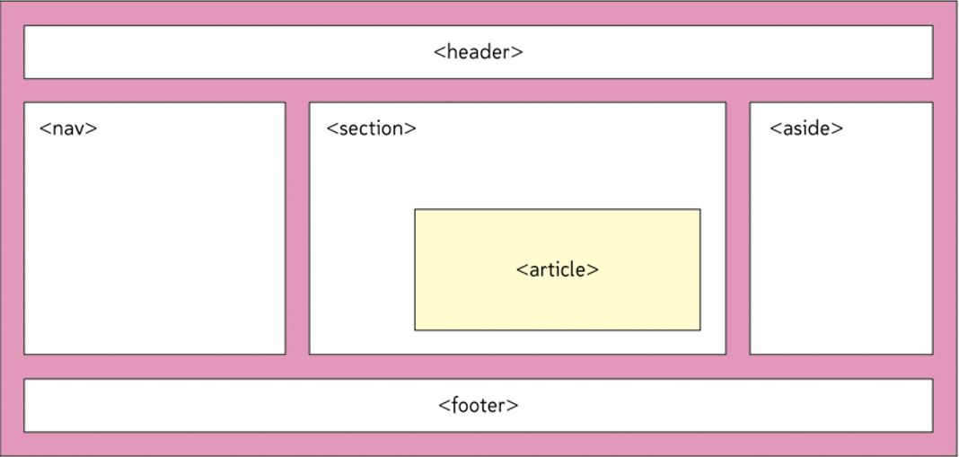
Structural elements
Notes:
Now, that you have a basic understanding of HTML elements, let’s take a look how the content on a web page can be organized.
Here are the basic structural elements defined in HTML 5. You can use them to structure the content of your web page.
Note, that these elements were introduced with HTML 5, and you might see equivalent old elements such as head, or body in old HTML pages on the web.

Slide 9
Basic Elements
Hypertext with anchor tag
Insert images with image tag
Numbered and unnumbered lists
<ul>, <ol>, <li> tags
Table structure for tabular data
<table>, <th>, <tr>, <td> tags
HTML Forms for accepting user input
<a href=“http://http://www.w3schools.com/”> Learn HTML here </a>
<img src=“myimage.jpg” alt=“descriptive text”>
Notes:
Here are some basic elements that are widely used.
Hypertext with anchor tag, lets you define hyperlinks to other documents. In the example shown here, you create a hyperlink to the text “Learn HTML here”. If you click on this link, the browser will take you to the w3schools.com web site.
You can insert images in a web page with the image tag, as shown here.
Numbered and unnumbered lists: <ul> tag for un-numbered list, <ol> for numbered or ordered list, <li> tags for list items.
Table structure for tabular data: using <table> tag. The elements nested within table tag are: <th> tag for table header, <tr> for table row, and <td> tag for table data.
HTML Forms for accepting user input, as you saw in your previous lab.
There are plenty more of these HTML elements, and you can learn more about them on the web.

Slide 10
Advanced HTML
HTML Graphics
<canvas> and <svg> tags
HTML Multimedia
<video>, <audio>, <source> tags
HTML API
Geolocation, Drag/Drop, Local Storage, etc.
➔ Learn and practice HTML at w3schools.com
Notes:
Here are some of the advanced features of HTML:
HTML Graphics tags are used for drawing objects on the web page. HTML provides canvas and svg (or scalable vector graphics) tags.
HTML multimedia tags for including audio and video on the web page
HTML API such as geolocation, drag/drop, local storage etc.
You can learn and practice HTML at w3schools.com site. Note, that w3schools has nothing to do with world wide web consortium, or W3C.
You can always view source of a rendered web page to see what HTML elements are used. On most browsers, you can do that by right click, and then select view page source.
Hope this gives you a good idea about what HTML is what they are used for. Let’s move on to the next technology – CSS.

Slide 11
Part 2 of 3 – Cascading Stylesheet (CSS)
Notes:
Let’s move on to part 2, Cascading Style Sheet or CSS

Slide 12
Topics
CSS Introduction
CSS Demo
CSS Syntax
CSS Selector
CSS Usage
Responsive Web Design (RWD)
Notes:
We will cover the following topics
CSS Introduction
CSS Demo
CSS Syntax
CSS Selector
CSS Usage
Responsive Web Design (RWD)

Slide 13
CSS Introduction
CSS describes how HTML elements are formatted and displayed in a web page
It can control layout of multiple pages at once
Decouples content from presentation
Styles cascade – attributes of a style override or combine with the attributes for previous style for a given element.
Current version 3 was released in 2012, specification owned by W3C
Notes:
Let’s learn about the next key technology for developing user interface for web applications: the cascading stylesheet or CSS.
CSS describes how HTML elements are formatted and displayed in a web page
It can control layout of multiple pages at once
Decouples content from presentation
Styles cascade – attributes of a style override or combine with the attributes for previous style for a given element. Override happens when attributes across two style rules are the same. Combination happens when there is no conflict.
Current version, 3 was released in 2012. CSS specification is also owned by the world wide web consortium or W3C

Slide 14
CSS Demo
CSS Demo
http://www.w3schools.com/css/demo_default.htm
https://www.bostonglobe.com/
Notes:
Here is a quick demo of what CSS can do.
You will see that the same content can look and feel very different, based on the stylesheet used.
Let’s take a look at these two examples.

Slide 15
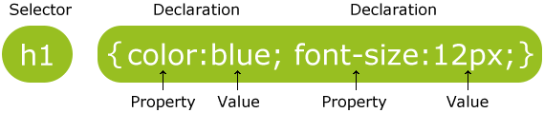
CSS Syntax
CSS rule set consists of a selector and a declaration block
Example
p { color: red; text-align: center; }
Notes:
Let’s take a look at CSS syntax.
CSS rule set consists of a selector and a declaration block. In the first example shown here, style rules for HTML heading element h1 are defined. The selector is h1, and the declaration block consists of values for color and font size. If this style is included in a web page, all the content marked by h1 elements, will be displayed with 12 point font and blue color.
In the second example, style rules for paragraph elements are defined. This this style is included, all the paragraphs on the web page will have a font color of red, and will be centered.
Image Credits: http://www.w3schools.com/css/css_syntax.asp

Slide 16
CSS Selector
Selector specify HTML elements to process
The element selector
The id selector
The class sector
p { color: red; text-align: center; }
#para1 { color: red; text-align: center; }
.center { color: red; text-align: center; }
Notes:
Selectors specify which HTML elements to process.
An element selector selects an HTML element, regardless of element id and class (note, that each HTML element can have an id and a class name).
The id selector, selects an HTML element by the given id
The class selector selects an HTML element by the specified class name
Examples taken from: http://www.w3schools.com/css/css_selectors.asp

Slide 17
CSS Selector (contd.)
Element with class selector
Grouping selectors
p.center { color: red; text-align: center; }
h1, h2, p {
color: red;
text-align: center;
}
Notes:
You can also make your style rule very specific to an element with given class name, as shown in the first example here.
You can also group the selectors with common style rules as shown here.
Examples taken from: http://www.w3schools.com/css/css_selectors.asp

Slide 18
CSS Usage
Three ways to insert CSS into a web page
External stylesheet
Internal stylesheet
Inline
<head> <link rel="stylesheet" type="text/css" href="mystyle.css"> </head>
<head>
<style> p { color: red; text-align: center; }
</style>
</head>
<h1 style="color:blue;margin-left:30px;"> Heading </h1>
Notes:
There are three ways to insert CSS into a web page.
External stylesheet – you can refer to a stylesheet file in the header section. This is most useful for styles that you want to apply to multiple pages in your web site.
Internal stylesheet - you can define styles inside the head section as shown in the example here, using <style> tags. This is most useful for styles that are specific to a page.
The Inline stylesheet – you can define style specific to one HTML element as shown here. Useful when there is something very unique and you do not want to use it anywhere else.
You can learn about stylesheet in depth at W3shools.com.

Slide 19
Responsive Web Design
An approach to web design which makes your web page look good on all devices
Uses CSS and HTML to resize, shrink, enlarge, and move content to make it look good on any screen
Uses fluid, proportion based grids, flexible images, and CSS 3 media queries
Why? – half the internet traffic is on mobile!
Notes:
Responsive Web design, is an approach to web design which makes your web pages look good on a range of devices from desktop computers to handheld smart phones.
It uses CSS and HTML to resize, shrink, enlarge, and move content to make it look good on any screen
It uses fluid, proportion based grids, flexible images, and CSS 3 media queries, to make web site content adapt to the size of browser window, which can be limited on smaller devices.
Why the Responsive web design? – because half the internet traffic is on mobile devices today!

Slide 20
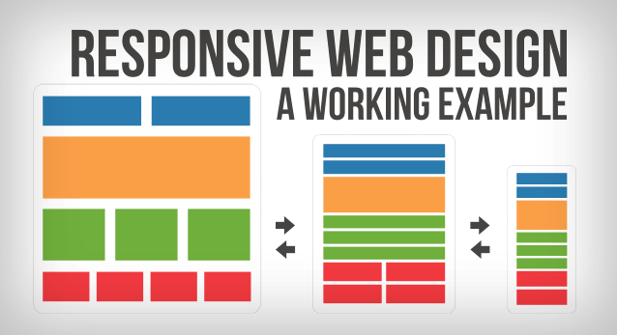
RWD Demo
http://morehazards.com/
https://www.bostonglobe.com/
Notes:
As shown in the image at the bottom right, a responsive web design adjusts the content for different size of screens on various devices. As you can see, the content is moved around to fit the screen.
Let’s now take a look at a couple of sites that implement the responsive web design concepts.
Hopefully you get a good understanding of CSS technology – what it is and how it is used for making good looking web sites.
Let’s move on to the next topic – JavaScript.

Slide 21
Part 3 of 3 – JavaScript, XML, and AJAX
Notes:
Let’s move on to part 3, JavaScript, XML, and AJAX

Slide 22
JavaScript
High level, dynamic, un-typed, interpreted programming language, used on web sites
Adds behavior to web pages – can modify HTML content and style
Along with HTML & CSS, forms the core of 3 essential technologies on the web
Inspired by Java language, invented by Netscape
Language specification owned by W3C, official name is ECMA Script, latest version ECMA6.
Notes:
What is JavaScript?
It is a high level, dynamic, un-typed, and interpreted programming language, used on web sites. All web browsers support it.
It adds behavior to web pages – can modify HTML content and style
Along with HTML & CSS, forms the core of 3 essential technologies on the web
Inspired by Java language, invented by Netscape
Language specification owned by W3C, official name is ECMA Script, latest version ECMA6.

Slide 23
JavaScript - Example
<!DOCTYPE html> <html><head><script> function myFunction() { document.getElementById("demo").innerHTML = "Paragraph changed."; } </script> </head>
<body>
<h1>My Web Page</h1>
<p id="demo">A Paragraph</p>
<button type="button" onclick="myFunction()">Try it</button>
</body> </html>
Notes:
Here is a simple example of JavaScript.
As you can see, there is a script tag in the header section. Under that there is a JavaScript function myFunction(), which modifies the HTML content of HTML elements on the web page with an id of “demo”.
Take a look at the body tag. There is a paragraph with an id of “demo”. The content of the paragraph is “A Paragraph”. Followed by the paragraph, there is a button that is linked to an event called onClick. When user clicks on this button, the java script function myFunction() is invoked, which then modifies the HTML content inside the paragraph.
This was a very simple example. JavaScript can respond to a very large number of page events such as mouse events, keyboard events, clipboard events etc. and add very sophisticated behavior to your web page.

Slide 24
JavaScript Usage
JavaScript code can be placed within <head> or <body> sections of an HTML page
It can also be placed in its own file (*.js), and included in the page using script element
JavaScript gets downloaded along with page contents, and executed on client’s browser
Good practice to keep JS files under doc root
<script src=“/js/myscript.js”></script>
Notes:
JavaScript code can be placed within <head> or <body> sections of an HTML page
It can also be placed in its own file (*.js), and included in the page using script element
As you can see the example here, the file myscript.js has been put under js folder directly under document root (i.e. WebContent)
JavaScript gets downloaded along with page contents, and executed on client’s browser
Good practice to keep files containing java script code under doc root

Slide 25
JavaScript Syntax
Syntax looks very similar to Java
Un-typed variables with keyword var
Declarations, statements, operators, loops, conditionals etc. are just like Java!
Supports objects (dynamic), arrays etc.
Does automatic type conversion, making the code very fluent and semantic
Notes:
JavaSript is based on Java Programming language and its syntax is very similar to it.
Variables in JavaScript are un-typed and use a keyword var.
Declarations, statements, operators, loops, conditionals etc. are just like Java!
Supports objects (dynamic), arrays etc.
Does automatic type conversion, making the code very fluent and semantic

Slide 26
JavaScript – Sample Code
var firstName, lastName, price, discount, fullPrice; var myArray = [], var myObject = {};
var i; firstName = “Abraham”; lastName = “Lincoln”; price = 20.00; discount = 0.10; // 10% discount fullPrice = price / (1 – discount);
for (i = 0; i < 10; i++) {
// code
}
Notes:
Here is JavaScript sample code. As you can see you can define variables, arrays, and objects. You can assign vales to them, compute something – here it is full price of something is being calculated, and a for loop to do something repetitively.
Hope this gives you a good idea about JavaScript syntax.
Getting deeper into JavaScript is beyond the scope of this class. However, you can, and should, learn more about JavaScript from a variety of sources on the internet. W3schools.com is a very good site for beginners and intermediate level programmers.

Slide 27
JavaScript Libraries
Advanced JavaScript programming can be difficult and time consuming
Browsers behave differently (different JS engine), and you must handle that as well.
To help with these, JavaScript libraries (also known as JavaScript frameworks) created
jQuery & Angular JS are popular frameworks
Notes:
Advanced JavaScript programming can be difficult and time consuming
Browsers behave differently (different JS engine), and you must handle that as well.
To help with these, JavaScript libraries (also known as JavaScript frameworks) created
jQuery & Angular JS are popular frameworks
You will use a little bit of jQuery in your lab. Getting deeper into these framework is beyond the scope of this class. However, there are several free resources on the internet. I recommend learning jQuery from w3schools.com

Slide 28
XML
EXtensible Markup Language
Designed to represent data, programming language neutral
HTML is special case of XML, with predefined tags!
<?xml version="1.0" encoding="UTF-8"?> <OSU-Class offering=“Autumn 2015”> <number>CSE 5234</number> <name>Distributed Enterprise Computing</name> <department>CSE</department>
</OSU-Class>
Notes:
Let’s take a brief look at XML technology.
XML stands for EXtensible Markup Language
Designed to represent data, programming language neutral
HTML is special case of XML, with predefined tags!
Here is an example of XML document. As you can see, there is an outer element named OSU-Class. Nested within this element are three other elements: number, name, and department. XML supports nested elements, and attributes – just like HTML.
An important thing to notice is that XML is just data. It does not DO anything by itself!
With this background, let’s now understand a key technology called AJAX.

Slide 29
AJAX
Asynchronous JavaScript And XML
Technique to update parts of a web page by making asynchronous calls to server
Helps in creating fast and dynamic web pages, making it look like rich client
Can request data from server, after the page has been loaded
Uses JavaScript & XML
Notes:
AJAX stands for Asynchronous JavaScript And XML
It is a technique to update parts of a web page by making asynchronous calls to server
It helps in creating fast and dynamic web pages, making it look like rich client
Can request data from server, after the page has been loaded. Obviously, it can send data to the server in the background.
Uses JavaScript & XML

Slide 30
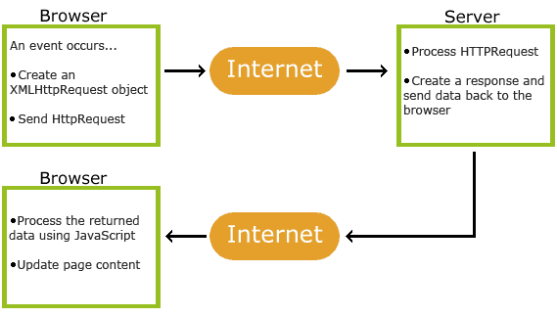
AJAX
Source: http://www.w3schools.com/ajax/ajax_intro.asp
Notes:
Here is a brief view of how AJAX works.
When an event occurs, such as a mouse click, or a keyboard event, a JavaScript code instantiates XMLHttpRequest object, and sends it asynchronously over to the server. The server processes the request, creates a response and sends data back to the browser. Note, that Server only sees a normal HttpRequest, so it does not know whether it is a normal request/response cycle or AJAX call from parts of a page.
Once server returns an HTTP response with required data, a listener JavaScript function on the page processes it and updates the page.
Source: http://www.w3schools.com/ajax/ajax_intro.asp

Slide 31
AJAX – HTML page
<!DOCTYPE html> <html> <body> <div id="demo">
<h2>Let AJAX change this text </h2>
</div> <button type="button" onclick="loadDoc()">Change Content</button> </body> </html>
Notes:
Here is an HTML page, which contains a button.
When button is clicked, it calls a JavaScript function called loadDoc()
All simple, so far! Much like any other regular Java Script usage.
Let’s now look at the java script code.

Slide 32
AJAX – JavaScript Code
function loadDoc() { var xhttp = new XMLHttpRequest(); xhttp.onreadystatechange = function() { if (xhttp.readyState == 4 && xhttp.status == 200) { document.getElementById("demo").innerHTML =
xhttp.responseText; } } xhttp.open("GET", “/UpdateDemo", true);
// true means asynchronous!
xttp.onreadystatechange = callback; xhttp.send(); }
Notes:
Here is the javascript code, which uses a very different logic.
It builds xttp request object, sends over to server using GET method, and that is done asynchronously.
Before sending request, it also sets up callback function, let’s take a look at it next.

Slide 33
AJAX – JavaScript Code
function callback( ) {
if (xhttp.readyState==4) { // called multiple times
if (xhttp.status == 200) {
var newTest = document.getElementById(“demo”);
newTest.value = xhttp.responseText;
}
}
}
Notes:
Here is the callback function. Its job is to set the content of the specified section of the page with response from the server.
This was a rudimentary example. In reality, AJAX can make a web site very slick and responsive to user activities. You can learn more about AJAX on internet, and certainly from w3schools.com website.

Slide 34
Single Page Web Applications
Web site that fits on a single web page, providing fluid desktop app like look & feel
Basic HTML, JavaScript, and CSS loaded in first go, then parts of the page & related styles/scripts are updated as necessary
Heavy use of AJAX, event based model
Angular JS framework
MVC – view rendering, controller & parts of model on the client side!
Notes:
Let’s introduce the concept of single page web applications.
This is a relatively new way to developing web applications, and it is very different from traditional web applications. The idea is that most of the user interface tier computation is shifted to the client’s machine, i.e. the browser. The server responds to fine-grained interactions from the client, based on user’s interaction.
The entire web site fits into a single web page, providing fluid desktop app like look & feel
Basic HTML, JavaScript, and CSS loaded in first go, then parts of the page & related styles/scripts are updated as necessary
It makes heavy use of AJAX, & event based model, as you would expect
Angular JS framework is currently the a popular framework to develop such web applications.
MVC – view rendering, controller & parts of model on the client side!
We will not be going deeper into single page web applications. Hopefully, this gives you a basic overview of what it is and what underlying technology it uses.

Slide 35
What have we learned?
1
2
HTML
3
Cascading Style Sheet & Responsive Web
Web UI Tier Overview
4
JavaScript
XML and AJAX
5
Single Page Web Application
6
Notes:
Let’s do a recap of what we learned today:
Web UI Tier Overview
HTML
Cascading Style Sheet & Responsive Web
JavaScript
XML and AJAX
Single Page Web App

Slide 36
References
HTML. In Wikipedia, The Free Encyclopedia. Retrieved June 2015, from https://en.wikipedia.org/wiki/HTML
HTML(5) Tutorial. W3Schools.com. Extracted August 2015, from: http://www.w3schools.com/html/default.asp
CSS Tutorial. W3Schools.com. Extracted August 2015, from: http://www.w3schools.com/css/default.asp
JavaScript Tutorial. W3Schools.com. Extracted August 2015, from: http://www.w3schools.com/js/default.asp
AJAX Tutorial. W3Schools.com. Extracted August 2015, from: http://www.w3schools.com/ajax/
Notes:
Here are a few references, which will help you get a deeper understanding of topics.

